Slide 1
Welcome To My Presentation

Slide 2
Research Article A New Approach to Dyeing of 60/40 CVC (Chief Value cotton) Fabric Using Disperse and Reactive Dyes.
Submitted To:
A B M Faisal
Senior Lecturer ,
Department of Textile Engineering
Southeast University
Submitted By:
Name: Hafezur Rahman
ID:2017200400017
Batch:36th

Slide 3
Abstract: The Aim of This work is To consumption of water with energy and Chemical And time .Dyeing of Polyester Cotton (PC or CVC) blended knit fabrics is done by two different types of dyestuff namely reactive dyes for cotton part and disperse dyes for polyester part in conventional two bath method where after polyester part dyeing the liquor is drained and then cotton part is dyeing . In Conventional Dyeing Method , for Dyeing of 5gm CVC 60/40 fabric ,The amount of water ,Chemical And Dyes is Calculated Considering 5 gm for Cotton And Also Consider 5gm for Polyester But In 5gm CVC 60/40 Fabric Actual Amount of cotton is 3 gm And Actual Amount of Polyester is 2 gm.This research work has been carried out on finding the possibility of dyeing this type of fabric Considering 3 gm Cotton And 2 gm Polyester of 60/40 CVC fabric of 5gm. Keywords: CVC blend fabric, CVC dyeing with a new Approach ,Water Saving ,Chemical Saving, CMC value, color fastness, cost analysis

Slide 4
Introduction: In worldwide polyester cotton (PC Or CVC) blended knit fabric is widely used due to their good aesthetic properties. 100% cotton knit fabric shows lower strength and crease resistance with higher absorbency where as 100% polyester fabric shows lower absorbency with higher strength and crease resistance. But PC or CVC blended fabric shows moderate strength and moderate crease resistance with an average absorbency. However, there are some requirements when dyeing is carried out of this type of fabric as the two fibres show two different types of characteristics. Cotton fibres show hydrophilic characteristics where as polyester fibres show hydrophobic characteristics. For this reason, it is impossible to dyeing polyester cotton blended fabric by using same dyestuffs. Conventionally polyester cotton blended fabric dyeing was carried out in separately using disperse and reactive dye with adequate control of temperature.

Slide 5
Materials And Methods: I)Fabric: 60/40 CVC CVC KNIT FABRIC CVC fabric is a resultant of polyester as well as cotton wool blending inwards the sure as shooting proportion. Interwoven CVC fabrics are characterized past times enlarged per centum of cotton wool yarn that provides amend hygienic properties inwards comparing amongst TC fabrics as well as amend strength characteristics inwards comparing amongst 100% cotton wool fabrics. Also they guarantee depression shrinkage, high color-fastness as well as perfect durability. Most types of CVC fabrics direct maintain the same constructions every bit T/C fabrics as well as differ from them past times enlarged per centum of cotton wool only. All CVC fabrics are suitable for function wear, uniforms as well as corporate wearing clothing for all sort of industries. CVC fabrics direct maintain a practiced hygienic properties, they are really comfortable to wearable as well as durable due to combination of polyester as well as cotton fibers.

Slide 6
ii) Dyes And Chemical: Disperse Dyes: Disperse dyes are non-ionic. They dye all the synthetic as well as cellulose acetate fibers past times using a direct dyeing technique. Only dyeing temperature varies from ane fiber to another. Thus they are ane of the major classes of dyestuff. The evolution of disperse dyes for dyeing secondary cellulose acetate fibers inwards the early on 1920’s was a major technological breakthrough. Their major usage today is for the coloration of polyesters, the most of import grouping of synthetic fibers. Disperse dyes are relatively insoluble inwards H2O at room temperature & direct maintain solely express solubility at high temperatures. They possess substantively for hydrophobic fibers such every bit nylon as well as polyester, inwards which they are quite soluble.

Slide 7
Dyeing Mechanism of Disperse Dye: The dyeing of hydrophobic fibres like polyester fibres with disperse dyes may be considered as a process of dye transfer from liquid solvent (water) to a solid organic solvent (fibre). Disperse dyes are added to water with a surface active agent to form an aqueous dispersion. The insolubility of disperse dyes enables them to leave the dye liquor as they are more substantive to the organic fibre than to the inorganic dye liquor. The application of heat to the dye liquor increases the energy of dye molecules and accelerates the dyeing of textile fibres. Heating of dye liquor swells the fibre to some extent and assists the dye to penetrate the fibre polymer system. Thus the dye molecule takes its place in the amorphous regions of the fibre. Once taking place within the fibre polymer system, the dye molecules are held by hydrogen bonds and Van Der Waals’ force.

Slide 8
Dyeing Mechanism of Disperse Dye:

Slide 9
REACTIVE DYE: Reactive dyes are the youngest as well as most of import dye course of written report for cellulosic material. Worldwide consumption of reactive dyes for cellulosic materials inwards mid 1980’s was well-nigh 10 to 12 %, whereas inwards Nippon lonely it represents well-nigh 40% of total dye consumption. The reactive dyes offering a broad arrive at of dyes amongst varying shades, fastness as well as costs amongst high brilliancy, slowly applicability as well as reproducibility. However, practiced training of the stuff is a prerequisite. The color yield as well as brilliancy of shades are enhanced significantly past times mercerization. The dyes are unstable to hypochlorite. Hence, bleaching amongst hypochlorites may do work during subsequent dyeing amongst reactive dyes. Reactive dyes comprise a chromospheres as well as a reactive group. They differ fundamentally from other dye classes inwards the fact they chemically react amongst the textile fiber forming covalent bonds.

Slide 10
Dye absorption: When fibre is immersed in dye liquor, an electrolyte is added to assist the exhaustion of dye. Here NaCl is used as the electrolyte. This electrolyte neutralize the negative charge formed in the fibre surface and puts extra energy to increase dye absorption. So when the textile material is introduces to dye liquor the dye is exhausted on to the fibre. Fixation: Fixation of dye means the reaction of reactive group of dye with terminal –OH or-NH2 group of fiber and thus forming strong covalent bond with the fiber and thus forming strong covalent bond with the fiber. This is an important phase, which is controlled by maintaining proper pH by adding alkali. The alkali used for this create proper pH in dye bath and do as the dye-fixing agent. The reaction takes place in this stage is shown below: Alkali D-SO2-CH2-CH2-OSO3Na + OH-Cell —————→ D-SO2-CH2-CH2-O-Cell + NaHSO3 pH 10-12.5 Alkali D-SO2-CH2-CH2-OSO3Na + OH-Wool ————-→ D-SO2-CH2-CH2-O-Wool + NaHSO3 pH 10-12.5

Slide 11
Chemicals: •Anti creasing agent • Detergent • Sequestering agent • Antifoaming agent • Stabilizer • Hydrogen peroxide • Peroxide killer • Enzyme • Buffer solution • Dispersing agent • Leveling agent • Softener • Gluber salt • Soda ash • Acetic acid

Slide 12
Scouring & Bleaching Combined Process: Scouring is done to remove impurities present on the fabric such as oil, wax, lubricants, dirt, surfactents, residual tints etc. where as bleaching is done to remove the natural color from the fibres. Typically NaOH is used at high temperatures for saponify and emulsify impurities in scouring process. For bleaching H2O2 and stabilizer are used to remove the natural color from fibres. H2O2 produces per hydroxil ions with the help of stabilizer which can remove the natural color from the fibre. Scouring & bleaching Detergent 1 gm/l Anti creasing agent 1 gm/l Sequestering agent 1 gm/l Wetting agent 1 gm/l Antifoaming agent 1 gm/l NaOH 5 gm/l H2O2 2.5 gm/l Stabilizer 1 gm/l M:L 1:8 Hot wash Peroxide killer 0.5 gm/l M:L 1:8

Slide 13
Neutralization: Acetic acid 1 gm/l M:L 1:8 Process: Scouring and bleaching is done combindly in 98 degree Celcius for 1 hour with the necessary chemicals menthioned in the table 1. The process for scouring and bleaching is shown in figure
Figure 1: Scouring & bleaching combined process curve
A = All chemicals of scouring bleaching dosing at room temperature
B = Peroxide killer dosing at room temperature
C = Acetic acid dosing at room temperature

Slide 14
Enzyme Bio-polishing and Dyeing Process: Scoured and bleached fabric is subjected to enzyme to remove the fuzzy or projecting from fabric surface. After enzyme bio-polishing polyester part of CVC blend fabric is dyeing with disperse dye by the help of dispersing agent at 1300 C temperature. After polyester part dyeing cotton part of CVC blend fabric is dyeing with reactive dye by the help of salt and soda at 600 C800 C temperature Recipe for enzyme wash Enzyme 0.5 gm/l Buffer 0.5 gm/l Acetic acid For pH 4.5 M:L 1:8 Dyeing Procedure Fabric=5 gm CVC 60/40 So Amount of Polyester=40%=40x5/100 =2 gm And Amount of Cotton =60%=60x5/100 =3 gm

Slide 15
Dyeing of Polyester: Recipe: Cora.G.Y.Hp3R=0.17% Cora .R.XF =0.022% Cora.B.XF =0.25% Acetic Acid =0.3 g/l Polyester levelling=0.5 g/l Temperature = 135 degre celcious Time =40 minute M:L =1:(4.5) PH =4.5 Calculation: Formula, Dye =(Material weight x recipe amount %) / (stock solution %) Formula, Chemical=(total Liquor in Litre) x (recipe amount in g/l) / Stock Solution %

Slide 16
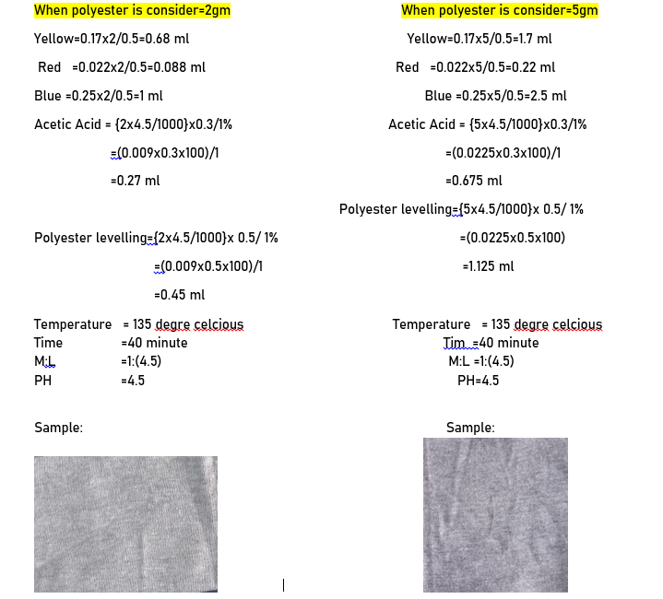

Slide 17
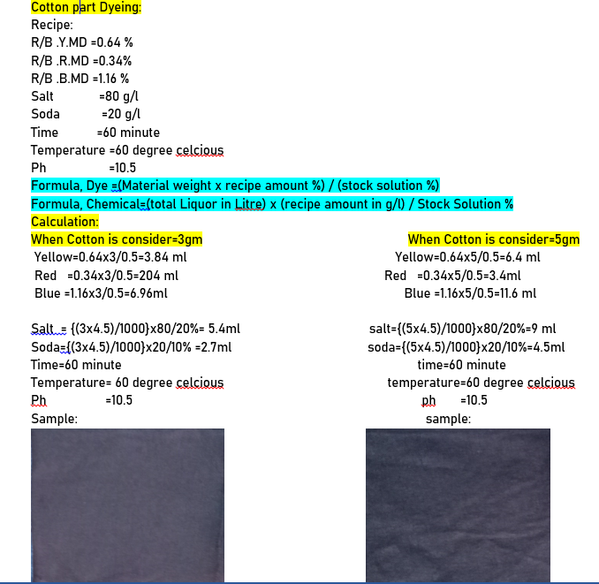

Slide 18
50 percent Addition For Polyester: Recipe: Cora.G.Y.Hp3R=0.17%=(0.17x50)/100=0.085+0.17=0.225% Cora .R.XF =0.022%=(0.022x50)/100=0.011+0.022=0.033% Cora.B.XF =0.25%=(0.25x50)/100=0.125+0.25=0.375% Acetic Acid =0.3 g/l Polyester levelling=0.5 g/l Temperature = 135 degre celcious Time =40 minute M:L =1:(4.5) PH =4.5 Calculation: Formula, Dye =(Material weight x recipe amount %) / (stock solution %) Formula, Chemical=(total Liquor in Litre) x (recipe amount in g/l) / Stock Solution

Slide 19
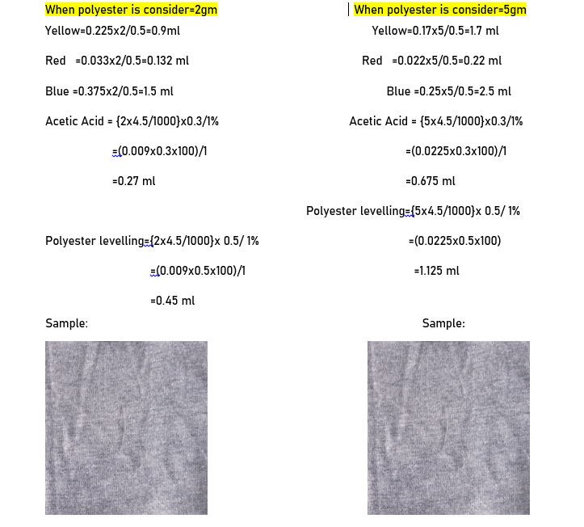

Slide 20
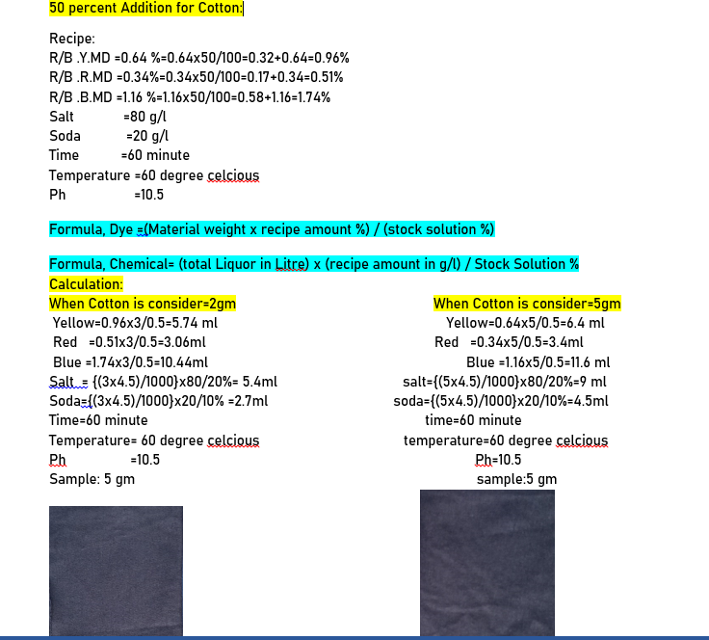

Slide 21
CMC Value Measurement: Color Measurement Committee (CMC) value is measured for determining pass or failure of a sample. The color of an object depends on the relative quantity of the light reflected or transmitted at different wavelengths within the visible range (400-700 nm). Spectrophotometric measurements provide the numerical description of the reflection or transmission of light by an object. The result was analyzed by a CIELAB color system. CIE (Commission Internationale de I’Eclairage) color coordinates include color qualities in terms of L* (lightness and darkness), a* (redness and greenness), b* (yellowness and blueness), C* (chroma) and H (hue angle, the angle of the anticlockwise movement from an axis of +a* direction, that is, +a*=00, +b*=900, -a*=1800, and –b*= 2700).
CMC REPORT:

Slide 22
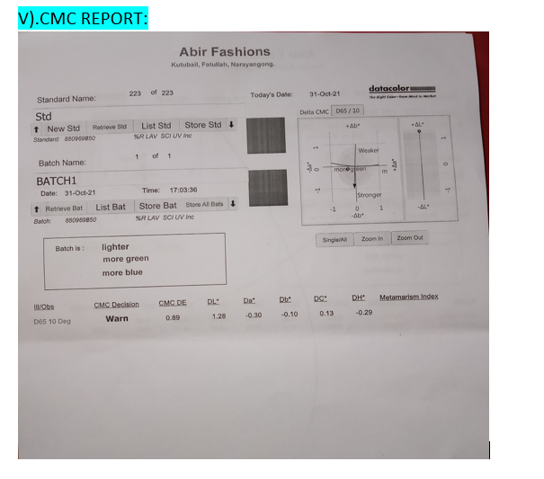
CMC REPORT

Slide 23

Results & Discussion: i).CMC Pass/Fail Values: CMC pass/fail values can be determined by spectrophotometer. If the CMC DE value is 1 or greater than the sample is failed. CMC DE values of THE New dyeing method (60% cotton i.e 3 gm, and 40% polyester i.e 2gm of total 5gm sample Seperately) is calculated with respect to the Traditional dyeing method sample. The CMC DE value is 0.89 ,so it is pass.

Slide 24
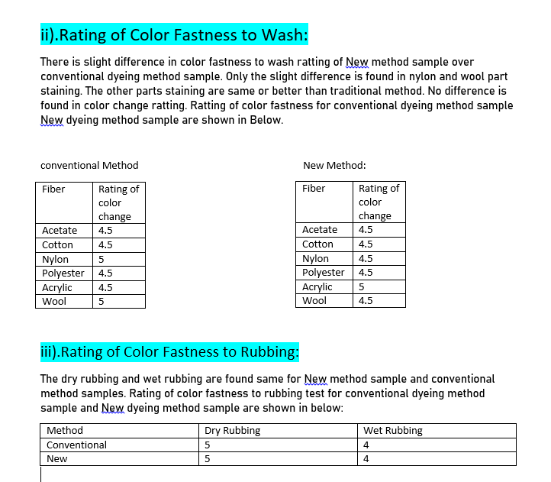

Slide 25
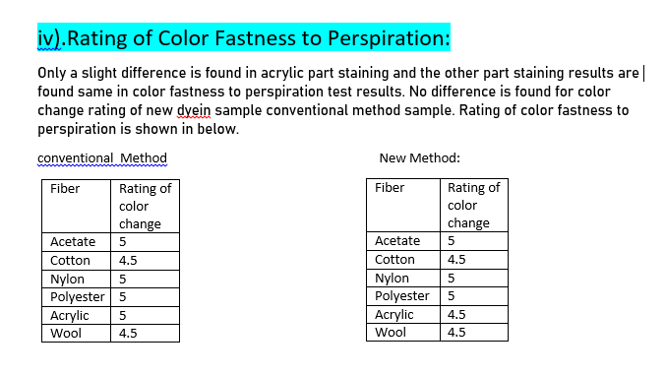

Slide 26
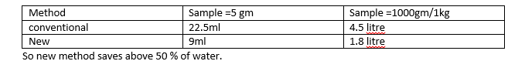
Amount of Water Required for polyester Part Dyeing: For Conventional Method: Amount of water required is calculated for 5gm fabric=5x(4.5)=22.5ml Amount of water required is calculated for 1000gm/1kg fabric=1000x(4.5)=4500ml/1000=4.5 litre For New Method: Amount of water required is calculated for 40 % polyester i.e 2gm of total fabric 5gm=2x(4.5)=9ml Amount of water required is calculated for 40 % polyester i.e 400gm of total fabric 1000gm/1kg=400x(4.5)=1800ml=1.8 litre

Slide 27

Amount of Water Required for Cotton Part Dyeing: For conventional Method: Amount of water required is calculated for 5gm fabric=5x(4.5)=22.5ml Amount of water required is calculated for 1000gm/1kg fabric=1000x(4.5)=4500ml/1000=4.5 litre For New Method: Amount of water required is calculated for 60% Cotton i.e 3 gm of total fabric 5gm=3x(4.5)=13.5ml Amount of water required is calculated for 60 % Cotton i.e 600 gm of total fabric 1000gm/1kg=600x(4.5)=2700ml=2.7 litre

Slide 28
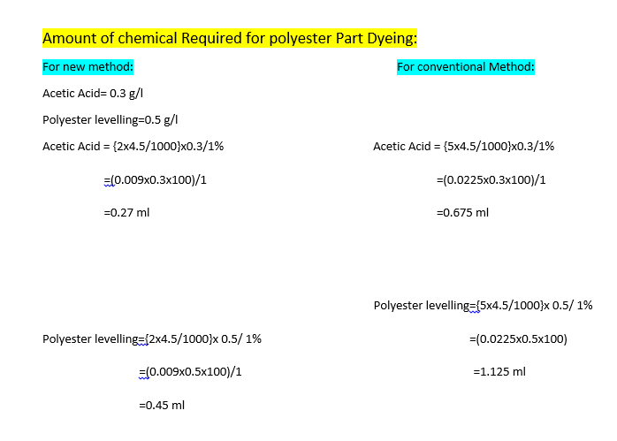

Slide 29
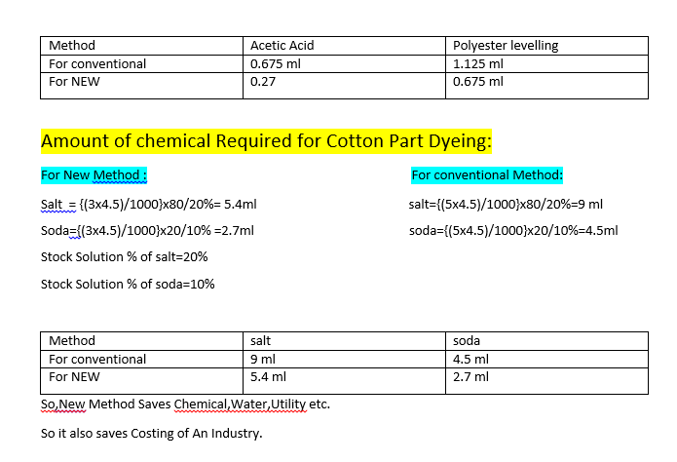

Slide 30
Conclusion: Dyeing of CVC blended fabric was successfully completed by New dyeing method. The New dyeing method was not cumbersome as other process because here no new chemicals have been used. The process has not needed any special requirements. The process is able to given the correct shade% by maintaining the process rightly. The New dyeing method for CVC blended fabric is a cost effective and eco friendly method compared to conventional dyeing method. Commercially it will be profitable if the process is accepted. Acknowledgement: During this work immense help was received from ABM Faisal, Senior Lecturer, Department of Textile Engineering, Southeast University , Bangladesh.My heartiest thanks and sincerest gratefulness was express for his continuous advice and encouragement. The cordial thanks and indebtedness is expressed to Instrument Engineer and Lab Technician, Abir Fashion, Narayangong, Bangladesh for their hard labor and co-operation during the research work. Real gratefulness to Engr.Amjad Ali, General Manage,Abir Fashions Ltd. to allow Me in the factory.

Slide 31
References: E.P.G. Gohl and L.D. Vilensky; “Textile Science”. New Delhi, India, 2005. B P Saville, “Physical Testing of Textiles”. The Textile Institute, Woodhead Publishing Limited, Cambridge, England, 2004 Arthur D Broadbent; “Basic principles of Textile Coloration”. Society of Dyers and Colorist (SDC), Bradford, West Yorkshire BDI 2JB, England, 2001.

Slide 32
Thank You All

